Slide 1
The Cheesecake Factory
Looking at the TEIS Data
Alex Fox, David Chaniott, Theodore Schwartz

Slide 2
Process of Cleaning the Data
Pulled all rows from the ‘Exit Note’ worksheet that included ‘reopened’
Pulled all dates from the ‘Exit Note’ column from those rows
Separated those dates between ‘Reopened:’ and ‘Exit Date:’ dates

Slide 3
Challenges
Solutions
Some dates were duplicated
Some dates were BEFORE the initial entry date
Some reopened dates were AFTER the final exit date
For dates that were duplicated:
We set them to null
For dates that were before the initial entry date:
We set them to null
For dates that were after the final exit date:
We set these dates to current day
For fixed dates that would then be AFTER the child’s 3rd birthday we set those dates to their 3rd birthday*
*These dates could just be erroneous, but this was the best outcome we could determine outside of ignoring those dates altogether.

Slide 4
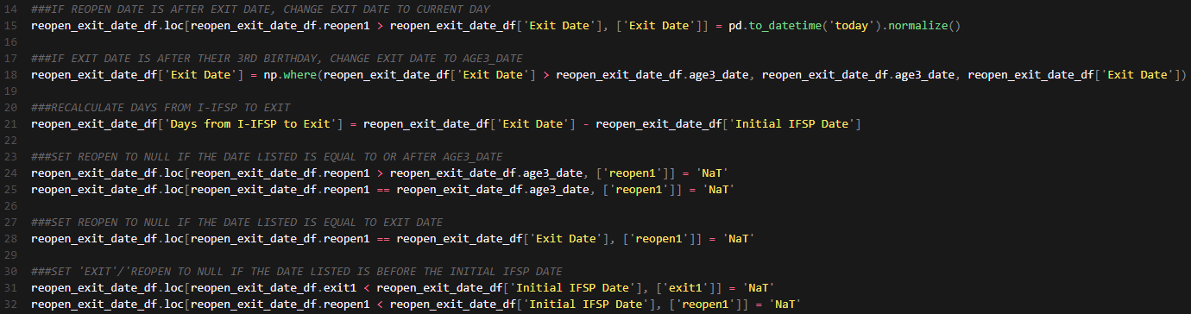
Solutions (visualized in Python)

Slide 5
Process of Cleaning the Data (cont.)
Calculated the differences between each pair of reopen and exit dates to find the actual gaps between service
Subtracted those calculated gaps in service time from listed service time to come up with the actual service time
Final step was to merge the fixed service times with the original sheet and calculate the reported data and totals

Slide 6
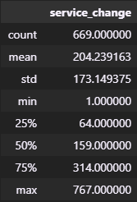
service_change.describe() table
This table shows a description of the children who had their service time change. We used absolute value as the difference was the important part, not whether it added or subtracted.
669 children had incorrect service times according to our work.
Of those 669, they were on average 204 days off their actual service time.
Total days off from actual: ~136,636

Slide 7
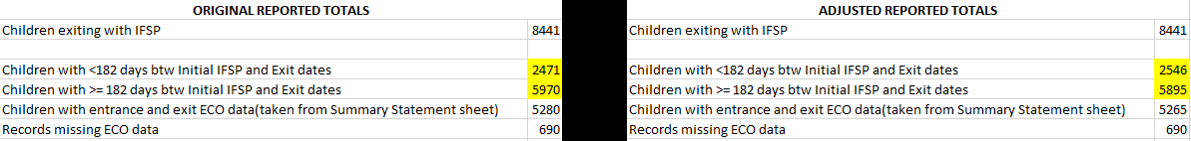
Reported Totals
Original vs Adjusted Reported Totals
Children with less than 182 days of service time
Original: 2471
Adjusted: 2546 (+75)
Children with more than 182 days of service time
Original: 5970
Adjusted: 5895 (-75)

Slide 8
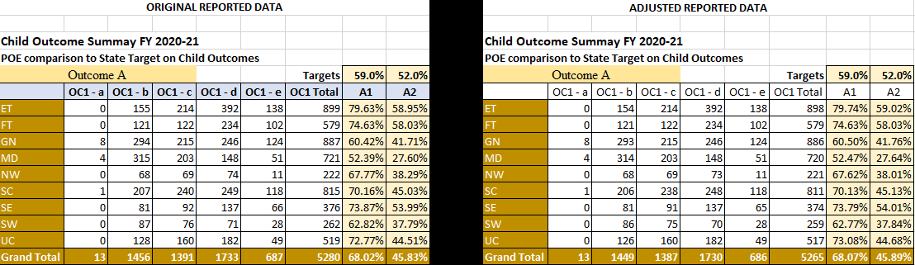
Reported Data (Outcome A)

Slide 9
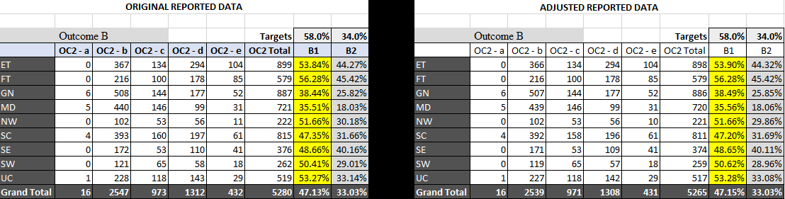
Reported Data (Outcome B)

Slide 10
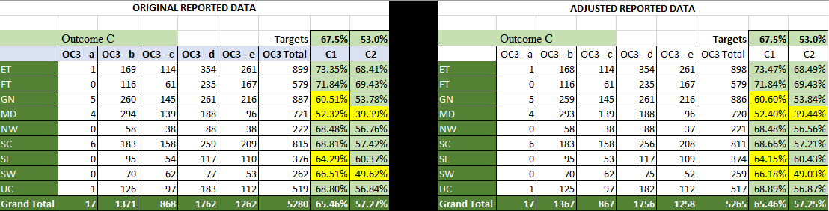
Reported Data (Outcome C)

Slide 11
Secondary Objective
How often are children aging out compared to other reasons?
What are the reasons for leaving and later coming back?
How often do children have less than six months of service time for reasons other than aging out?

Slide 12
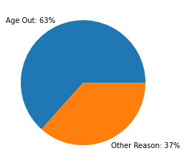
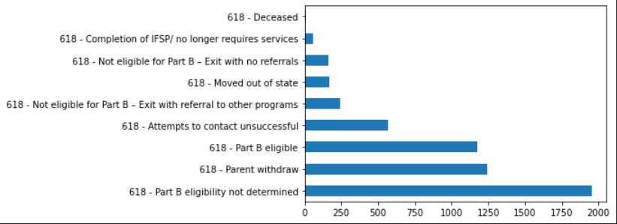
Reasons for Exiting TEIS

Slide 13
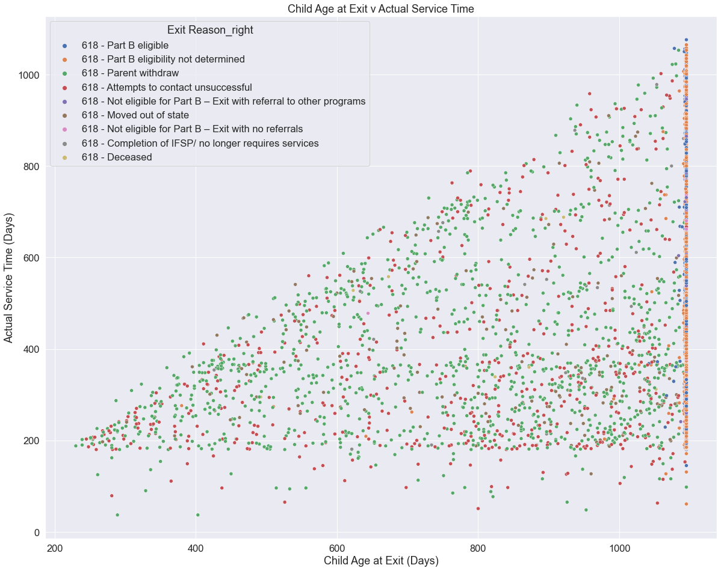
Exit Reasons by Child Age and Service Time in Days

